Slide 1
Review for midterm
Management Information Systems
Disha Parkhi

Slide 2
One-to-many relationship
A
1 M
B
Each record of table A corresponds to 0, 1, 2,….(many) records of table B
Each record of table B corresponds to 1 record of table A
To create this relationship we put the primary key of A as a foreign key in table B (the foreign key is always in “the many” table).
The foreign key may be left empty (null), in which case it means that the record of B corresponds to 0 records of A.

Slide 3
Subtypes
A
1 0 /1
B
Each record of table A corresponds to 0 or 1 record of table B
Each record of table B corresponds to 1 record of table A
To create this relationship we put the primary key of A as a foreign key in table B and also as its primary key (this ensures that to each record of B corresponds a single record of A).

Slide 4
many-to-many relationship
M M
A
W
B
Each record of table A corresponds to 0, 1, 2, … records of table B
Each record of table B corresponds to 0, 1, 2, … records of table A
To create this relationship we create a new table W. The primary key of table A and of table B are foreign keys in table W.

Slide 5
Anomalies
Anomalies are problems caused by poor database design.
An update anomaly occurs when one must make many changes to reflect the modification of a single piece of information.
A deletion anomaly occurs when data is deleted from a relation, and other critical data is unintentionally lost
An insertion anomaly occurs when a row cannot be added to a table, because not all data is available (or one has to invent “dummy” data)

Slide 6
Normal forms
Normal forms are rules that help prevent anomalies.
1NF: all tables’ attributes are atomic: no nested tables or subtables; no attribute should be a list of values; no repeating groups of attributes
  2NF: 1NF + any non-key field cannot depend on part of the primary key
3NF: 2NF + No non-key attribute is dependent on any other non-key attribute or composition of any non-key attributes, EXCEPT if the latter attribute(s) could have been used as an alternative key of the table.

Slide 7
Review on normal forms and DB anomalies

Slide 8
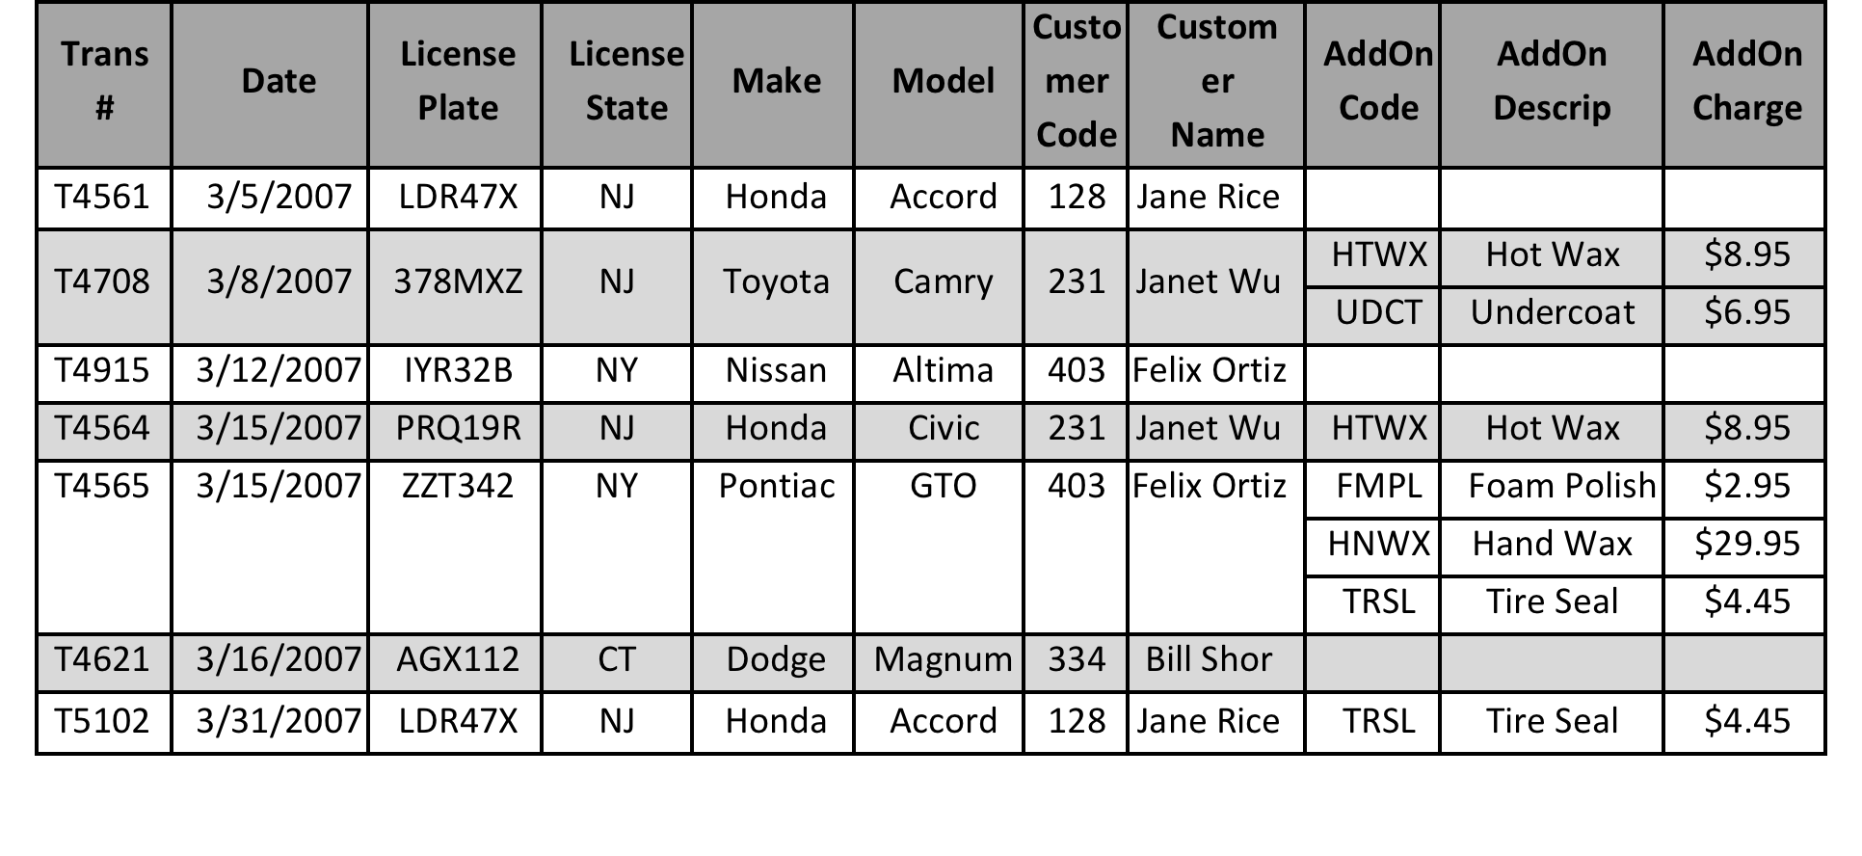
Consider a car wash company that keeps records using a table similar to the following simplified table whose PK is “Trans #”:
Each record corresponds to a single car wash (transaction), and contains the following information: date of the transaction, license plate, license state, make and model of the car, customer code and customer name. The fields AddOnCode, AddOnDescrip, and AddOnCharge are allowed many rows for each transaction, each indicating which optional services were added to the basic wash operation.
You may assume that the car wash always charges the same amount for each optional service.

Slide 9
Questions
1. Give examples of insertion, deletion and update anomalies.
2. Is the table in 1NF? 2NF? 3NF? Why?
3. Fix the table so that it is in 3NF.

Slide 10
Solution to 1.
Insertion anomaly: it is not possible to insert information about a new add-on, unless there is a transaction with it.
Deletion anomaly: if I delete a transaction I can potentially loose information about the existence of an add-on: e.g. since the add-on named Undercoat shows up only on transaction # T4708, if I delete it, I loose information about the existence of that add-on and its price.
Update anomaly: if a customer changes name, that update may need to be done many times in the DB (as many as the number of transactions from that customer); if I need to update either the description of the add-on or the charge that will imply many updates to the database (as many as the number of transactions with that specific add-on).

Slide 11
Solution to 2.
1NF?
No, because there is a table inside of a table.
2NF?
No, because it is not in 1NF.
3NF?
No, because it is not in 1NF and also because we have non-key attributes depending on other non-key attributes: “Customer Name” depends on “Customer Code”; Make and Model depend on (LicensePlate, LicenseState); “AddOn Descrip” and “AddOn Charge” depende on “AddOn Code”.

Slide 12
Solution to 3.
Assuming a car is always taken by the same person (the owner).
CAR (LicensePlate, LicenseState, Make, Model, CustCode)
CustCode foreign key to CUSTOMER
CUSTOMER (Code, Name)
ADDON (Code, Descrip, Charge)
TRANSACTION (Trans#, Date, CarLicPlate, CarLicState)
(CarLicPlate, CarLicState) foreign key to CAR
ADDONAPPLIED (Trans#, AddOnCode)
Trans# foreign key to TRANSACTION
AddOnCode foreign key to ADDON
M
ADDON
APPLIED
M
CUSTOMER
TRANSACTIONS
ADDON
1
M
M
CAR
1

Slide 13
Solution to 3. – another option
Assuming a car can be taken by multiple people.
CAR (LicensePlate, LicenseState, Make, Model)
CUSTOMER (Code, Name)
ADDON (Code, Descrip, Charge)
TRANSACTION (Trans#, Date, CarLicPlate, CarLicState, CustCode)
(CarLicPlate, CarLicState) foreign key to CAR
CustCode foreign key to CUSTOMER
ADDONAPPLIED (Trans#, AddOnCode)
Trans# foreign key to TRANSACTION
AddOnCode foreign key to ADDON
1
M
M
ADDON
APPLIED
M
CUSTOMER
TRANSACTIONS
ADDON
M
1
CAR

